Slide 1
CERTIFIED ETHICAL HACKER
PHANI KISHORE LANKA

Slide 2

What is HACKING
Unauthorized Access to Machines
An Unconventional way to making things
Happen to function is called Hacking.
Hacking Refers to Exploiting System Vulnerabilities
And compromising security controls to gain
Unauthorized or inappropriate Access to system
Resources. It Involves Modifying system or Application
Features to achieve a goal outside of Creators Original
Purpose.
Hacking = Goal + Vulnerabilities + Exploit.

Slide 3


WHO Is HACKER
Individual who spends plenty of time exploring computer hardware and software for finding vulnerabilities for illegal purposes.

Slide 4

WHO IS ETHICAL HACKER
Ethical Hacker is a Computer Security Expert
Who specializes in Penetration Testing & in Other
Testing methodologies to ensure that the security
Of Organization Information System.

Slide 5
Hacking TERMINOLOGIES
VULNERABILITY :- Existence of Weakness in Design or Implementation that can lead to an Expected event compromising security of the system.
EXPLOIT :- A Breach of IT System Security through Vulnerabilities.
PAYLOAD :- Pay load is a Part of Exploit Code that performs the Malicious Action on the Target Machine.

Slide 6








Types of HACKERS
BLACK HAT :- Their Purpose is to Destroy Things, Individuals with Extra ordinary skills utilize for Malicious or Destructive Activities
WHITE HAT :- Individuals utilizing Hacking skills for Defensive Purposes (Security Analysts)
GREY HAT :- Partimers, Individuals who work as Offensive and Defensive at times.
SUICIDE HACKERS :- Individuals who aim to bring down critical infra for a cause and are not worried about punishment.
SCRIPT KIDDIES :- Unskilled Hacker who compromises System by running scripts, tools and software developed by real hackers.
CYBER TERRORISTS :- Individuals with wide range of Skills motivated by Religious or Political Beliefs to create feat by large-scale Disruption of Computer Networks.
HACTIVIST :- Individuals who promote Political Agenda by Hacking , Especially by Defacing Or Disabling Websites.
GOVERNAMENT SPONSORED :- Work for Govt to Penetrate and Gain Top Secret info.

Slide 7
PHASES OF HACKING
INFORMATION GATHERING (FOOT PRINTING)
SCANNING (Network scan, Port Scan, Vulnerability Scan , Software Detection, OS Detection)
Gaining Access – Search and Built exploit and attack with exploit.
Maintaining Access – Maintaining Access with Payload.
Cleaning Tracks – Removing Traces.

Slide 8
ELEMENTS of INFORMATION SECURITY
Information Security is a state of Well being Information and Infrastructure in which the possibility of theft , tampering and disruption of Information and services is kept low or tolerable.
CIAAN
Confidentiality – Ensure No Leak , Right info is given to right People
Integrity – Policy that ensures no tampering done to your data.
Availability – Ensure system to be available all the time.
Authenticity – Authentication & Authorization
Non Repudiation – Policy that proves that attacks are not done, there is a log for every attack.

Slide 9
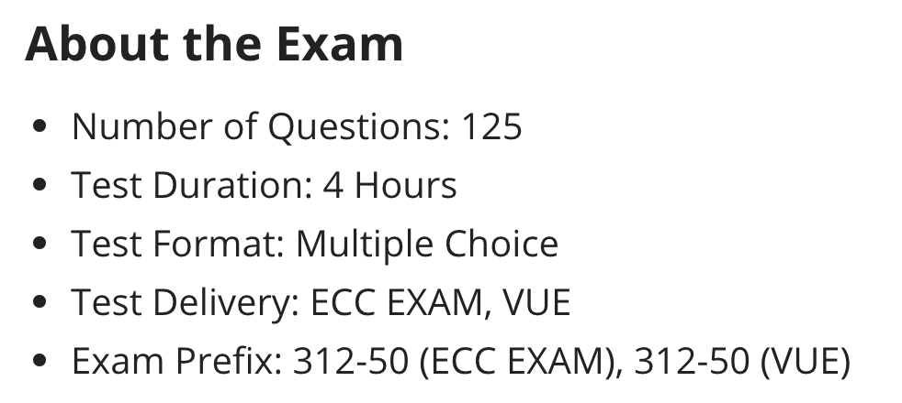
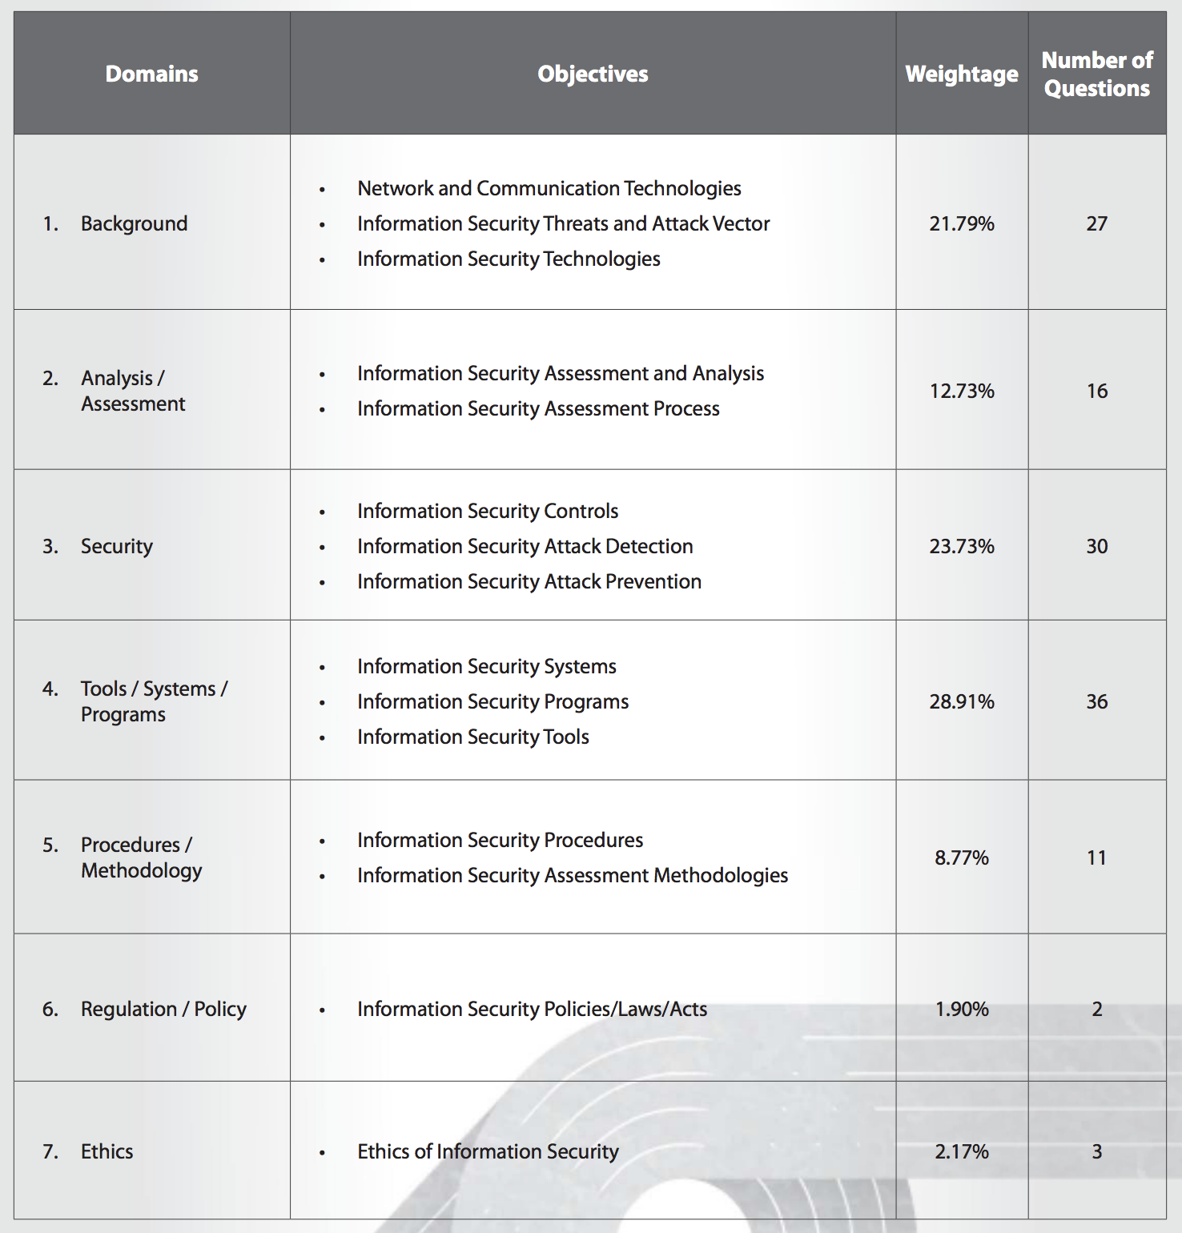
CERTIFIED ETHICAL HACKER
Exam Blueprint :- https://www.edusum.com/ec-council/ec-council-ceh-ceh-v10-exam-syllabus
1. Introduction to Ethical Hacking
2. Footprinting and Reconnaissance
3. Scanning Networks
4. Enumeration
5. Vulnerability Analysis
6. System Hacking
7. Malware Threats
8. Sniffing
9. Social Engineering
10. Denial-of-Service
11. Session Hijacking
12. Evading IDS, Firewalls, and Honeypots
13. Hacking Web Servers
14. Hacking Web Applications
15. SQL Injection
16. Hacking Wireless Networks
17. Hacking Mobile Platforms
18. IoT Hacking
19. Cloud Computing
20. Cryptography

Slide 10
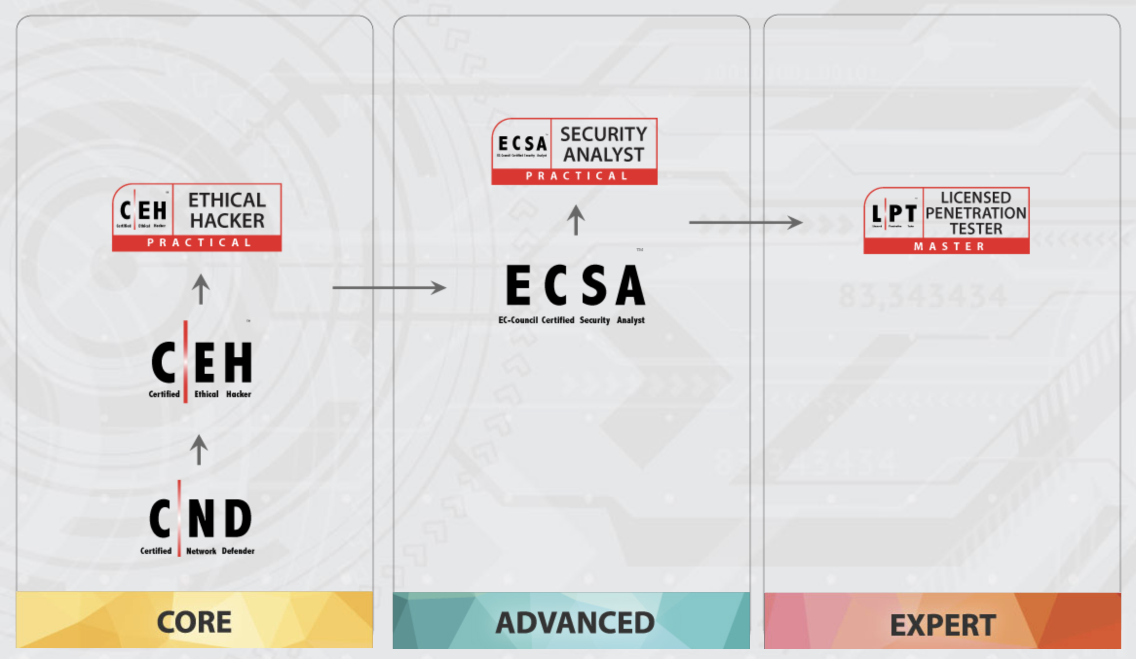
EC COUNCIL CERTIFICATION PATH

